Slide 1
PRICE PREDICTION OF REAL ESTATE
By D.Shane
Batch: 2021-6832

Slide 2
TABLE OF CONTENTS
01
02
03
Problem Statement
Why this project?
Dataset description
04
05
06
EDA
Result & discussion
Conclusion
First, lets see about our problem statement
Here, we will see the reason I chose to take this project
We will see the detailed description of our data
Lets see some analysis based on our dataset
Lets see the performance of our model
At last we will see the conclusion of my project

Slide 3
1.Problem Statement

Slide 4
PROBLEM STATEMENT:
We have to predict the price of the real estate properties based on their total square feet area , number of bathrooms and number of bedrooms.

Slide 5
2.Why I chose this project?

Slide 6
WHY I CHOSE THIS PROJECT?
Prediction of real estate prices are expected to help people who plan to buy a house so they can know the price range in the future, then they can plan their finance well. In addition, real estate price predictions are also beneficial for property investors to know the trend of housing prices.

Slide 7
3.Dataset Description

Slide 8
DATASET DESCRIPTION:
This dataset has been taken from kaggle.com.
This dataset contains 13321 rows and 9 columns.
The following are the of detailed description the variables.
1.area_type- Tells about the saleable area of the property.
2.availability- Tells when the property is ready to move in.
3.location- Tells the location of our property.
4.size- Tells the number of bhk.
5.society- Tells what type of society the property is in.
6.total_sqft- Gives the total square feet area.
7.bath-Tells the number of bathrooms.
8.balcony-Tells the number of balcony.
9.price-This is our target variable which we have to predict. We have to take our price as lakhs in Indian rupees.

Slide 9
4.Exploratory Data Analysis

Slide 10
EXPLORATORY DATA ANALYSIS:
In my dataset there were 1304 values in location column , so it was very complicated to perform EDA on the dataset.
To overcome that I filtered the data and chose the top three locations . Which are Whitefield , Sarjapur Road and Electronic City .

Slide 11
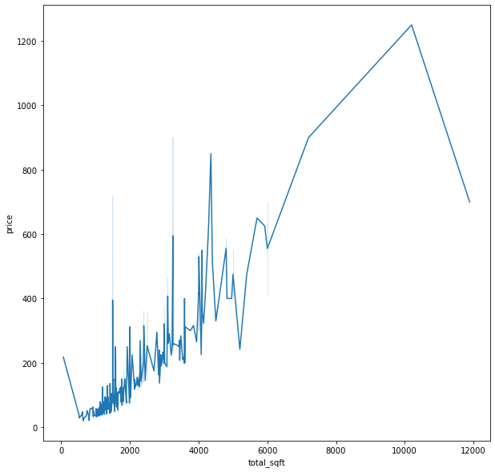
LINEPLOT BETWEEN PRICE AND SQFT IN WHITEFIELD:

Slide 12
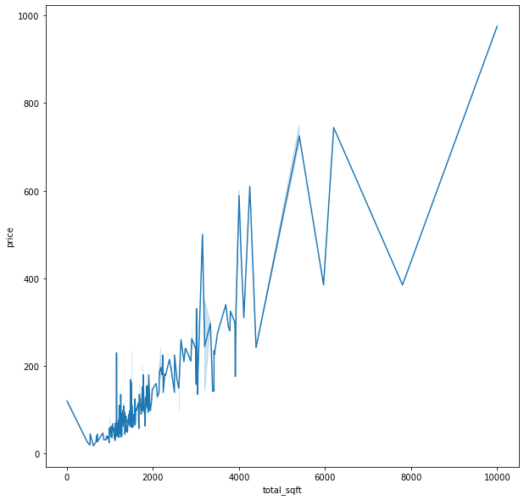
LINEPLOT BETWEEN PRICE AND SQFT IN SARJAPUR ROAD:

Slide 13
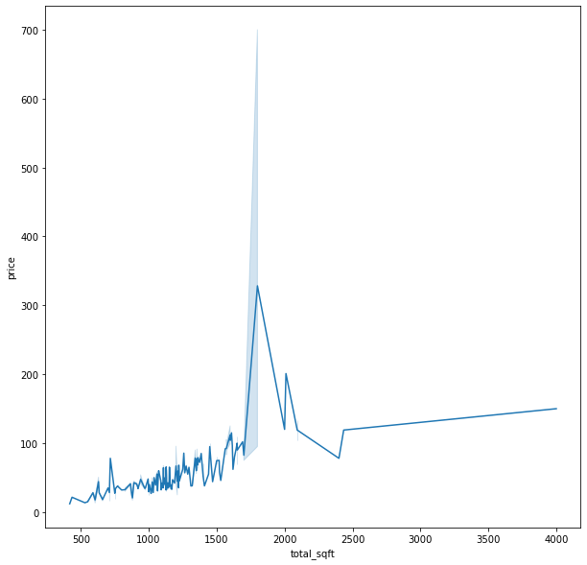
LINEPLOT BETWEEN PRICE AND SQFT IN ELECTRONIC CITY:

Slide 14
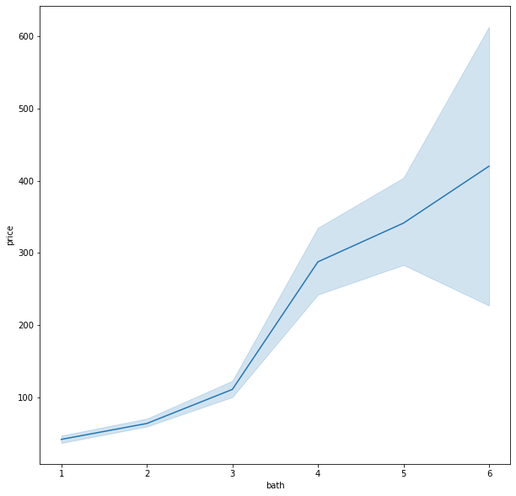
LINEPLOT BETWEEN PRICE AND BATH IN WHITEFIELD:

Slide 15
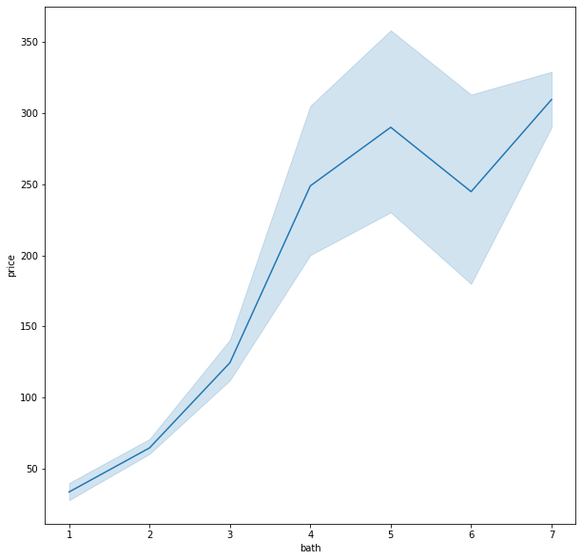
LINEPLOT BETWEEN PRICE AND BATH IN SARJAPUR ROAD:

Slide 16
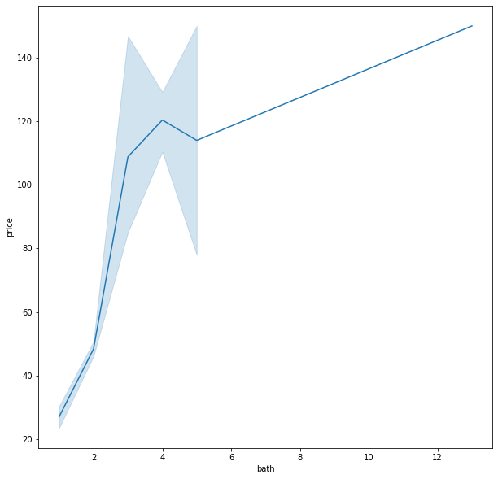
LINEPLOT BETWEEN PRICE AND BATH IN ELECTRONIC CITY:

Slide 17
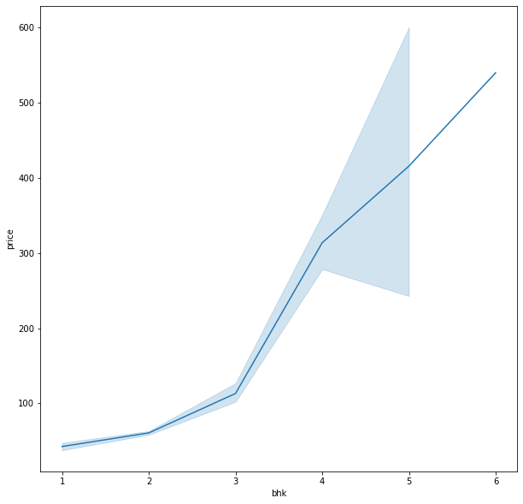
LINEPLOT BETWEEN PRICE AND BHK IN WHITEFIELD:

Slide 18
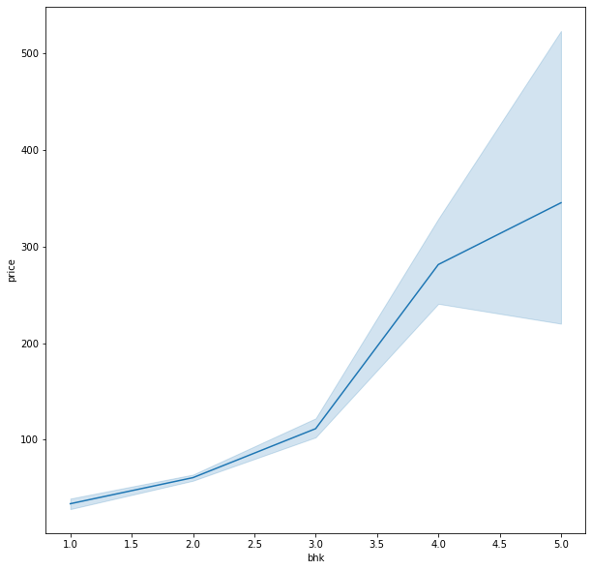
LINEPLOT BETWEEN PRICE AND BHK IN SARJAPUR ROAD:

Slide 19
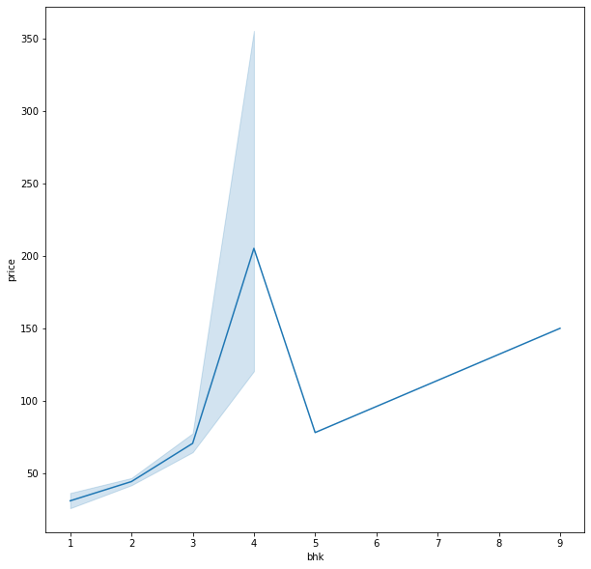
LINEPLOT BETWEEN PRICE AND BHK IN ELECTRONIC CITY:

Slide 20
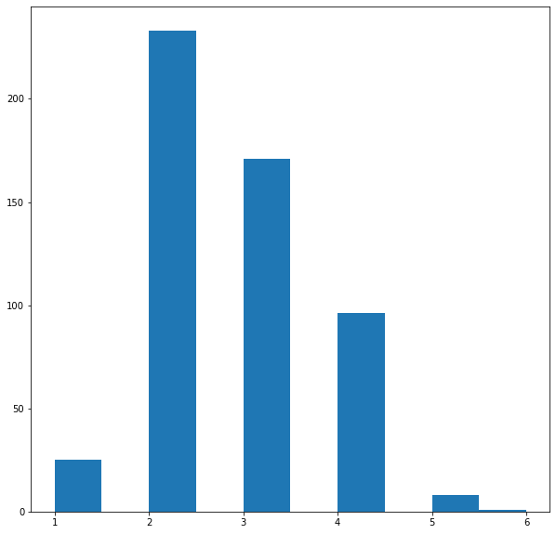
HISTOGRAM OF NO.OF BEDROOMS IN WHITEFIELD:

Slide 21
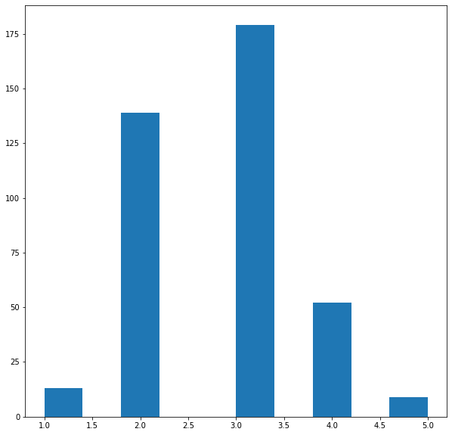
HISTOGRAM OF NO.OF BEDROOMS IN SARJAPUR ROAD:

Slide 22
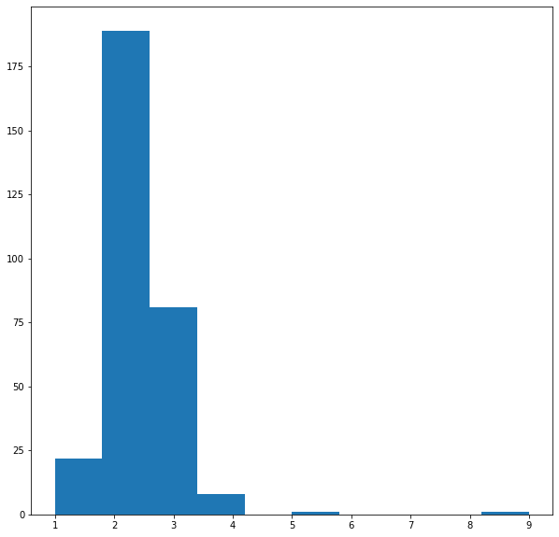
HISTOGRAM OF NO.OF BEDROOMS IN ELECTRONIC CITY:

Slide 23
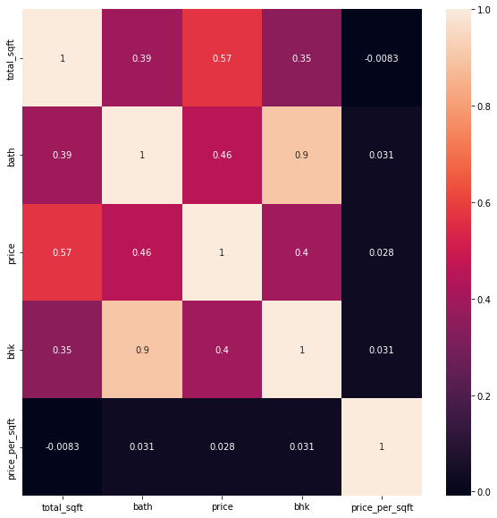
HEATMAP FOR OUR DATASET:

Slide 24
5.Results & Discussion

Slide 25
RESULTS AND DISCUSSION:
To predict the prices of the real estate properties I used Linear regression algorithm . Also I have GridsearchCV to select the best algorithm for this price prediction. I have used the K-fold cross validation technique to estimate the performance of my model . I used 10 groups of data to evaluate the performance of my model and the average accuracy of my model was 84% .

Slide 26
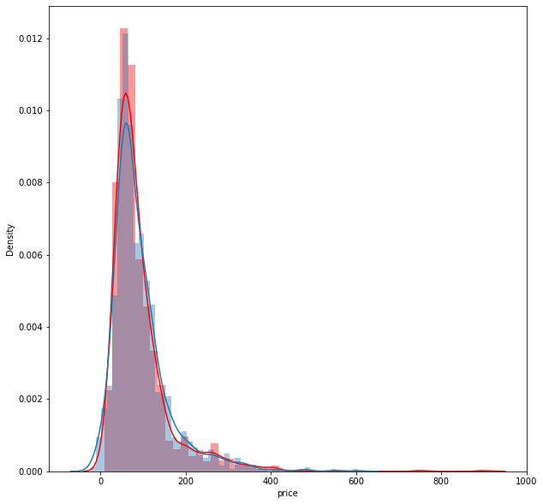
TRUE VALUES VS PREDICTED VALUES:

Slide 27
6.Conclusion

Slide 28
CONCLUSION:
Price prediction of real estate properties.
It is very helpful for those who buy and invest in properties.
We saw the detailed description of my dataset.
We saw the EDA of my dataset.
We saw how I built my model and the performance of my model.

Slide 29
THANKS
Does anyone have any questions?

